Slide 1
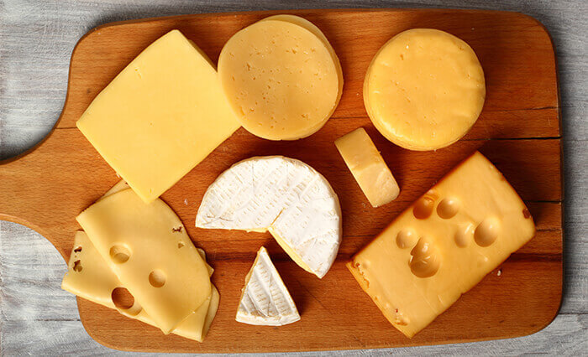
Whey Waste
Background:
A by-product of producing cheese is whey.
Whey is the liquid remaining after milk has been curdled and strained.
One pound of cheese makes nine pounds of whey.

Slide 2
Whey Waste
Scenario:
Most dairies/cheese processing plants dispose of whey. It can be spread on fields to naturally decompose (adding some minor nutrients for growing crops).
Can the whey be used for something else?
Can the whey be turned into a value-added product?

Slide 3
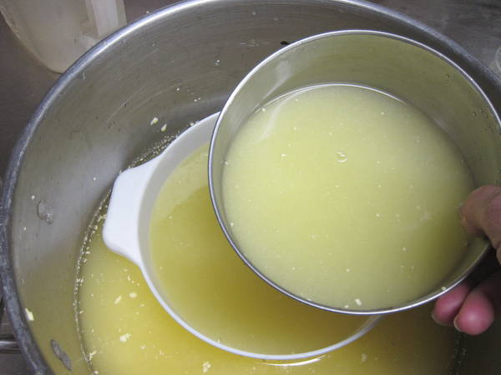
Whey Waste
Wet or Dry?
Whey is primarily water and proteins
In the liquid form it is very heavy.
The water can be removed with a drier. Small machines might cost upwards of $250,000 and aren’t feasible for most small dairies or milk processors.

Slide 4
Whey Waste
Wet
Make ricotta - add milk, harvest curds
Make mozzarella - make ricotta, then stretch curds in hot water
Make butter - left to cool some sediment can be collected
Make pesticide (mildew) – dilute with water and spray on plants
Add to smoothies, sodas, and pickling vegetables
Feed it to animals - locally
Natural face cleanser, hair conditioner
Soup stocks, baking additive, soak nuts and grains for cooking
PROBLEM: All of these are small scale

Slide 5
Whey Waste
Dry
Feed it to animals – more easily transported
Protein powder – dietary supplement for humans
Filtered to isolate individual components (protein, lactose, fat)
PROBLEM: Drying is very expensive

Slide 6
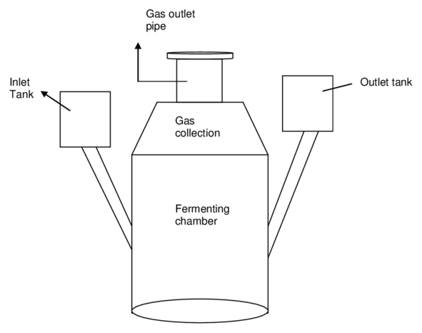
Whey Waste
Other Solutions
Biodigester – microbial reaction to break whey down and turn it into biogas and eventually electricity
PROBLEM: The capital infrastructure to build is millions of dollars

Slide 7
Whey Waste
Student Engineering Challenge
Assign students one of the potential solutions to using whey waste.
Consider a cheese producer that produces 50,000 pounds of cheese per year (so 450,000 pounds of whey).
Would their solution be feasible?
What are the constraints of the scenario?
How could they make it feasible?
Have students create a decision matrix to analyze their findings.

Slide 8
Whey Waste
Decision Matrix
List all of your options as the row labels on the table and list the factors that you need to consider as the column headings. For example, if you were buying a new laptop, factors to consider might be cost, dimensions, and hard disk size.
Work your way down the columns of your table, scoring each option for each of the factors in your decision. Score each option from 0 (poor) to 5 (very good). Note that you do not have to have a different score for each option – if none of them are good for a particular factor in your decision, then all options should score 0.
The next step is to work out the relative importance of the factors in your decision. Show these as numbers from, say, 0 to 5, where 0 means that the factor is absolutely unimportant in the final decision, and 5 means that it is very important. (It's perfectly acceptable to have factors with the same importance.)
Now multiply each of your scores from step 2 by the values for relative importance of the factor that you calculated in step 3. This will give you weighted scores for each option/factor combination.
Finally, add up these weighted scores for each of your options. The option that scores the highest wins!

